Slide 1

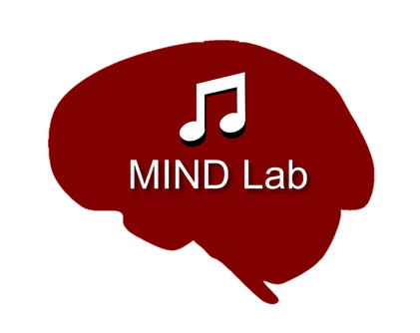


EARLY LIFE ADVERSITY REVEALS ADAPTIVE USE OF ABSORPTION INTO MUSIC
Nicholas Kathios*, Kelsie Lopez*, Laurel Gabard-Durnam^, Psyche Loui^
24 August 2023 Presented by Nicholas Kathios ICMPC 2023

Slide 2

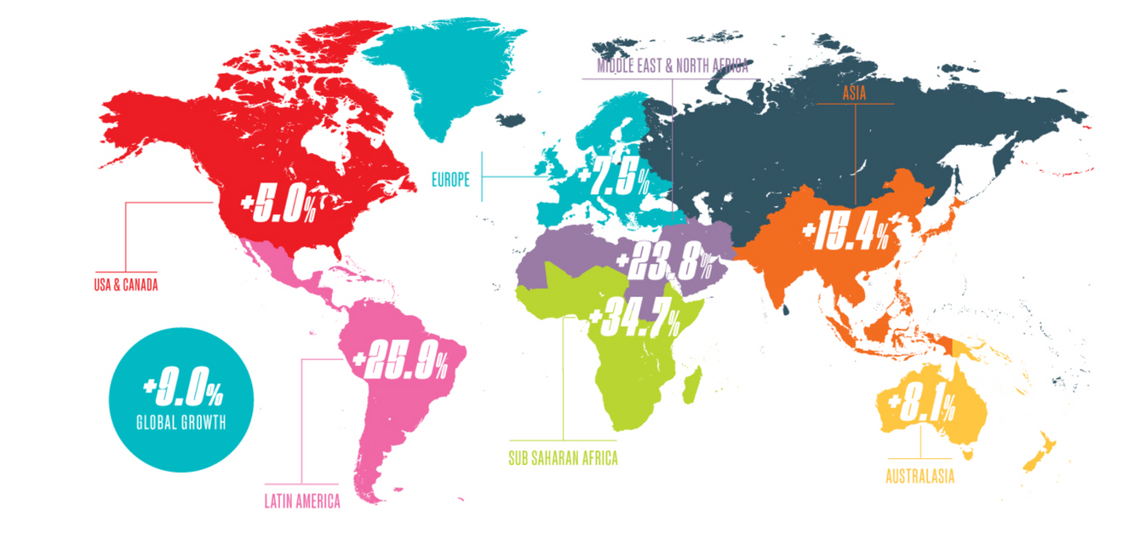


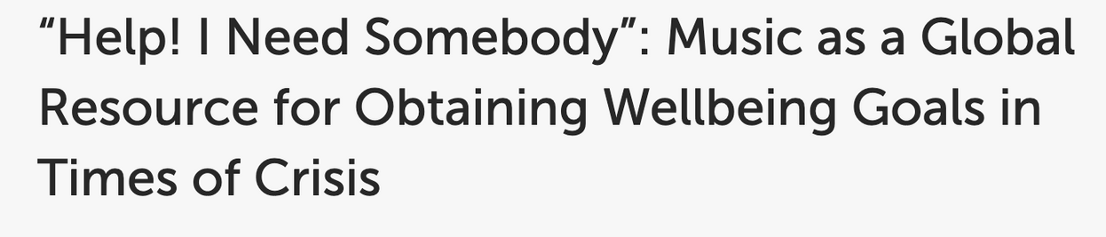
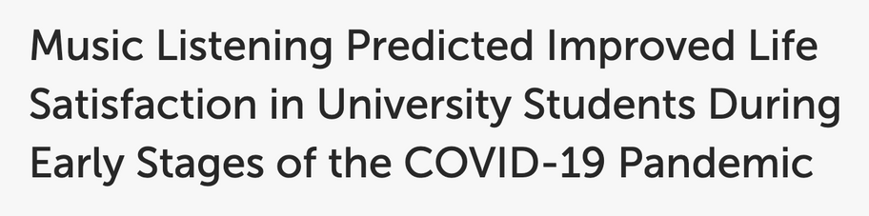
International Federation of the Phonographic Industry
2
e.g. Granot, Spitz et al., 2021; Hennessy et al., 2021; Krause et al., 2021; Thoma et al., 2012; Ziv & Hollander-Shabtai, 2021
Notes:
Around the globe, individuals listen to a TON of music. A recent report has revealed that global music consumption increased by 9% from 2021 to 2022, with average hours of music consumed increasing from 18 to over 20 hours per week. One highly cited reason why individuals listen to music is for mood regulation: this is especially apparent in the wake of the COVID19-pandemic, which confirmed music’s ability to down regulate negative emotions in stressful contexts.

Slide 3
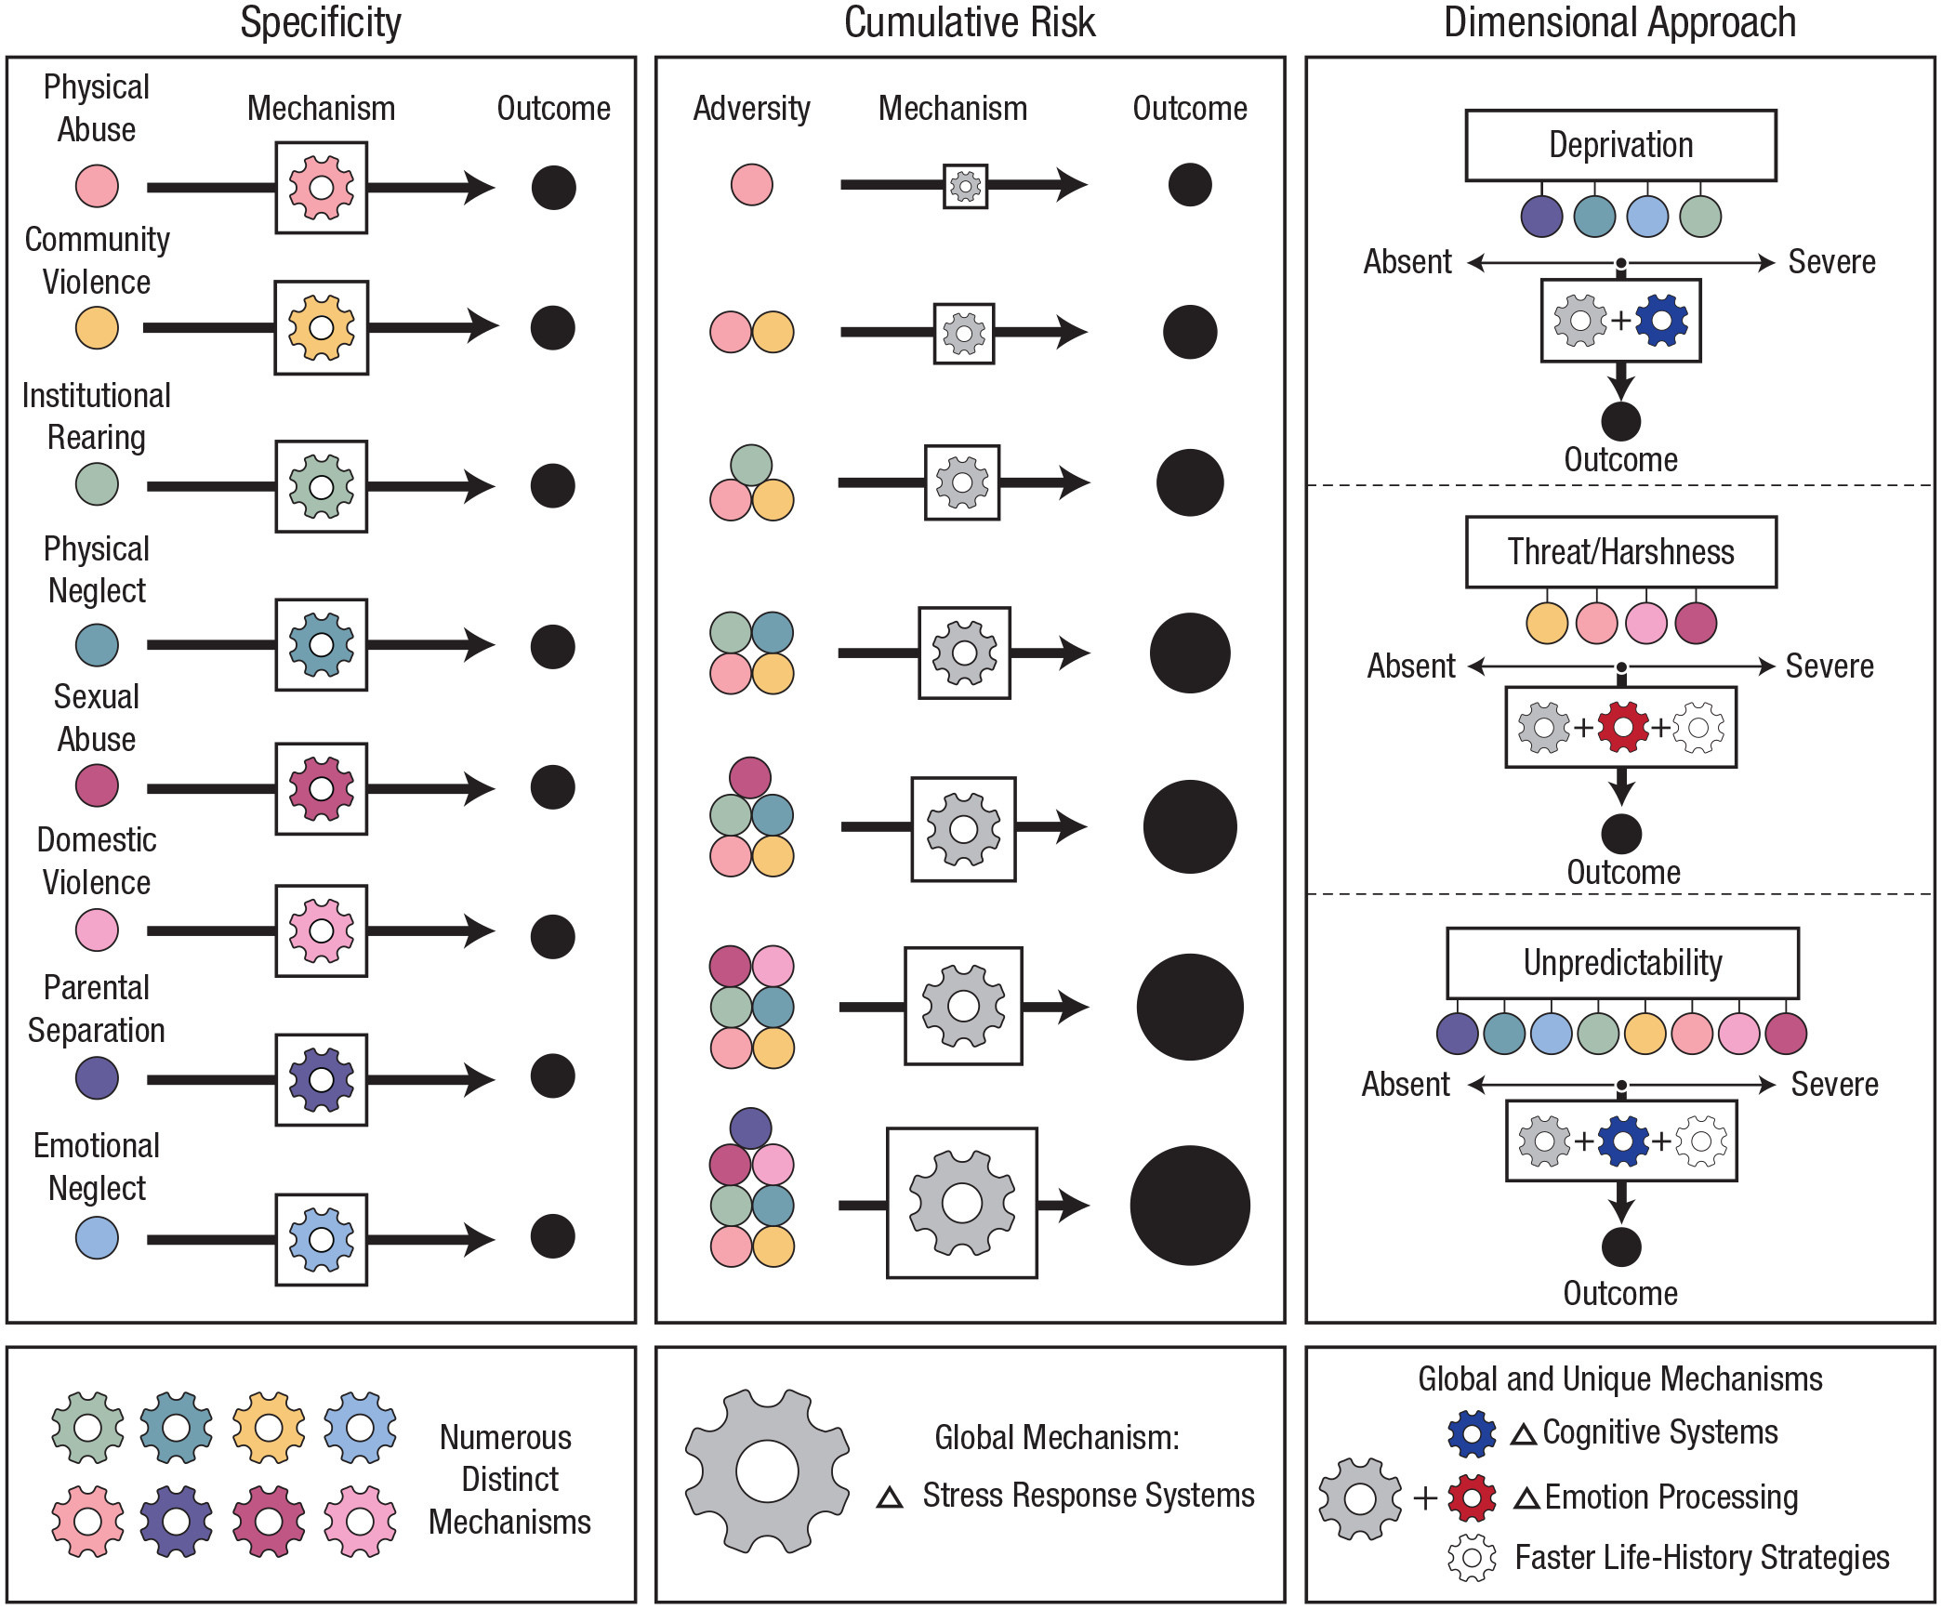

EARLY LIFE ADVERSITY: CUMULATIVE RISK
In general, greater exposure to ELA results in higher vulnerability to mental illness & lower resilience as adults ….
Assumptions:
distinct adversities act upon the same mechanism
each experience has equal & additive outcomes
McLaughlin et al., 2021
3
Notes:
While these studies examine how music usage effectively regulate negative emotions in response to a global stressful event, another way we can measure the presence of stress in individuals’ lives is through measuring exposure to early life adversity, which has a rich history of cross-species work. In this context, early life adversity refers to a broad set of negative experiences in early life, such as physical abuse or parental separation. Historically, one popular approaches to study the effects of such experiences in development on adult behavior is the “cumulative risk” model, which essentially treats each experience as a binary (present or absent), and is a count-based measure of how much adversity and individual has experienced. Now while this may seem like a rather broad-strokes measure, this approach has shown us that exposure to adverse experiences does put individuals at greater risks for mental illnesses and lower resilience as adults. However, this model does not offer much insight into how these experiences translate into these downstream effects because of its two key assumptions …

Slide 4
EARLY LIFE ADVERSITY: DIMENSIONAL MODEL
Goal: identify core dimensions of experiences that occur in multiple types of adversity
absence of expected environmental input
exposure to or risk of physical
or psychological harm
stochastic variation in the environment
McLaughlin et al., 2021
4
Notes:
These shortcomings, however, are addressed in the dimensional model of ELA, which has the goal of … This approach is supported by work that shows that the type and timing of early life experiences have differential downstream effects. This work has identified three dimensions of ELA:
As a result, the dimensional model of ELA aims to measures potential shared mechanisms across separate experiences of adversity. Current research suggests there are three such dimensions of adverse experiences: deprivation, threat, and unpredictability. Not only does this approach give a bit more mechanistic clarity than the cumulative risk model, but it also extends the binary of present/absent to measure the experiences of adversity as continuous measures as a function of both severity of these experiences. This is the approach we will be using in the current study.

Slide 5



HOW MIGHT EXPOSURE TO ELA IMPACT MUSIC USAGE?
Exposure to adverse environments (across dimensions)
Improved adult mental health
(i.e. improved resilience)
More incentive to engage in regulatory behavior
Higher music usage for regulation
5
Notes:
So how might these experiences relate to music usage? Well, in the same way in which COVID19 was a stressful context in which individuals turned to music, we believe that individuals who experience adverse home environments—across all dimensions—might ….
And, as mentioned previously, as ELA is an antecedent of mental illness, if individuals who are exposed to ELA turn to music as a way to regulate, then it might also be the case that such behaviors might be related to improved adult mental health.

Slide 6
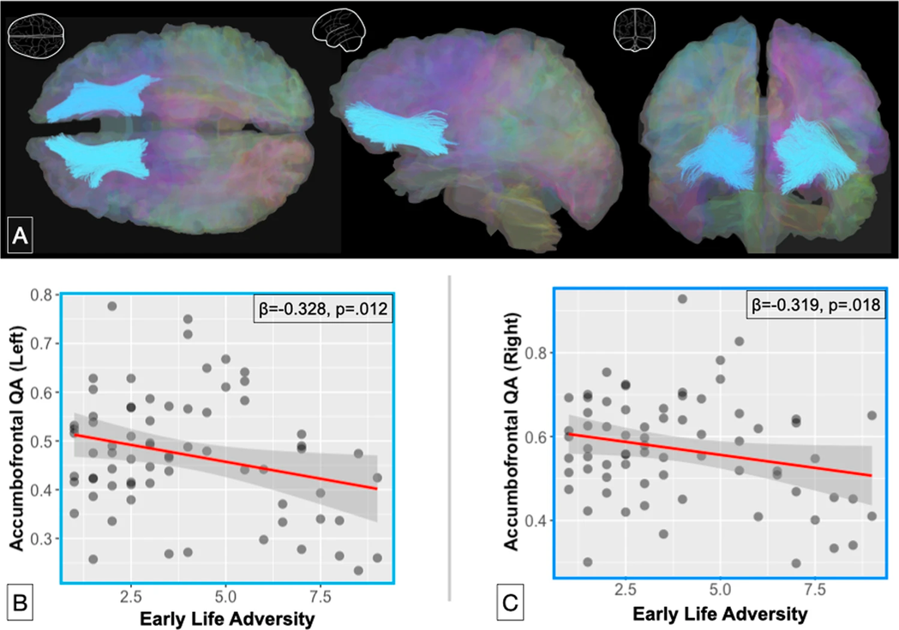
EARLY LIFE ADVERSITY & REWARD PROCESSING
e.g. Belfi & Loui, 2020; Dennison et al., 2019; Glynn et al., 2018; Kennedy et al., 2021
6
Notes:
However, this picture might not be as clear cut as I’ve made it out to be. A considerable degree of the positive emotions music evokes is due to its ability to engage the brain’s reward system, which relies heavily on learned reward predictions, as outlined in the neuroanatomical model I’ve included on my slide. Interestingly, one important neural connection between the striatum and medial prefrontal cortex, both important components of reward system that is engaged during music listening, has *decreased* volume as a function of adversity experienced, which leads to things like altered reward learning and higher risk of general anhedonia. Thus, individuals who have been exposed to early life adversity might experience *decreased* music pleasure because of how these experiences alter the reward system.
Degree of ela → changes in the same brain areas involved in reward processing. This is also related to higher risk of inability to experience reward.
Think about removing belfi + loui, and just saying involvement of reward system is well replicated … move to DTI

Slide 7
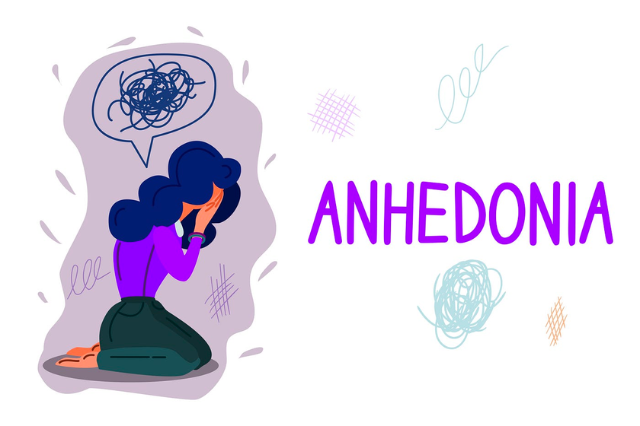

HOW MIGHT EXPOSURE TO ELA IMPACT MUSIC USAGE?
Exposure to adverse environments
Implicated development of reward system & reduction in reward responsivity
Less music enjoyment & usage of music for regulation
7
Notes:
So, a competing pathway to the one I previously presented can be built:

Slide 8

PARTICIPANTS
254 participants (140F; mean age = 38) recruited from a previous experiment
Extended Barcelona Music Reward Questionnaire (eBMRQ):
Emotion Evocation
Mood Regulation
Music-Seeking
Social Reward
Sensorimotor Reward
Absorption
STUDY 1 METHODS
8
Cardona et al., 2022
Notes:
To test these competing predictions, we conducted a …. These participants had previously completed the eBMRQ, which is a measure of individual differences to music reward sensitivity on six different facets.

Slide 9

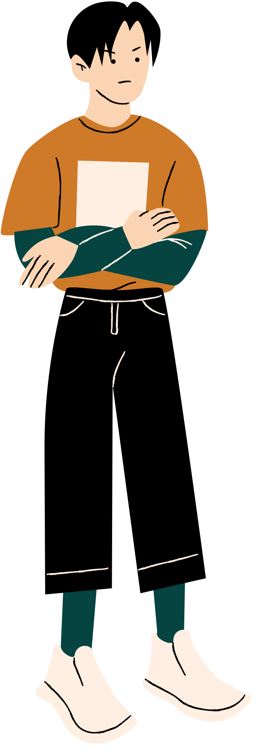
ADVERSITY MEASURES
UNPREDICTABILITY
DEPRIVATION
THREAT
Confusion, Hubbub, and Order Scale
(CHAOS)
Questionnaire of Unpredictability in Childhood
(QUIC)
McLaughlin Deprivation and Threat Scales
"At least one of my caregivers changed jobs frequently."
"At home we can talk to each other without being interrupted.”
(Reverse scored)
"How often did you not have regular meals to eat?"
"How often did a caregiver threaten to abandon you as a child?"
Childhood (6-12)
Adolescence (13-18)
Glynn et al. 2019; Matheny et al., 1995; McLaughlin et al., 2014
9
Notes:
To measure adversity dimensionally, we administered a suite of questionnaires aimed at assessing each of the three dimensions of adversity.
Each measure was retrospectively reported for experiences both in childhood and adolescence. With these reports, we generated three scores per adversity measures: one per each time period and a third summing scores across these time periods which represents the total extent of adversity experienced across these time points.

Slide 10

ALL DIMENSIONS OF ELA ARE POSITIVELY ASSOCIATED WITH REPORTS OF ABSORPTION INTO MUSIC
Absorption: an individual’s ability and willingness to allow music to draw them into an emotional experience
“While listening to music, I may become so involved that I may forget about myself and my surroundings.”
Colors indicate r value; asterisks denote significance level * p < .05, ** p <.01, *** p <.001
10
Notes:
The first result I am going to show you are bivariate correlations between the adversity measures across both time points and sum-scored. In this correlation matrix, the colors represent the r-values of these correlations, with red colors indicating positive and blue colors indicating negative correlations. The asterisks themselves represent the significance level of these correlations. When we look at …

Slide 11
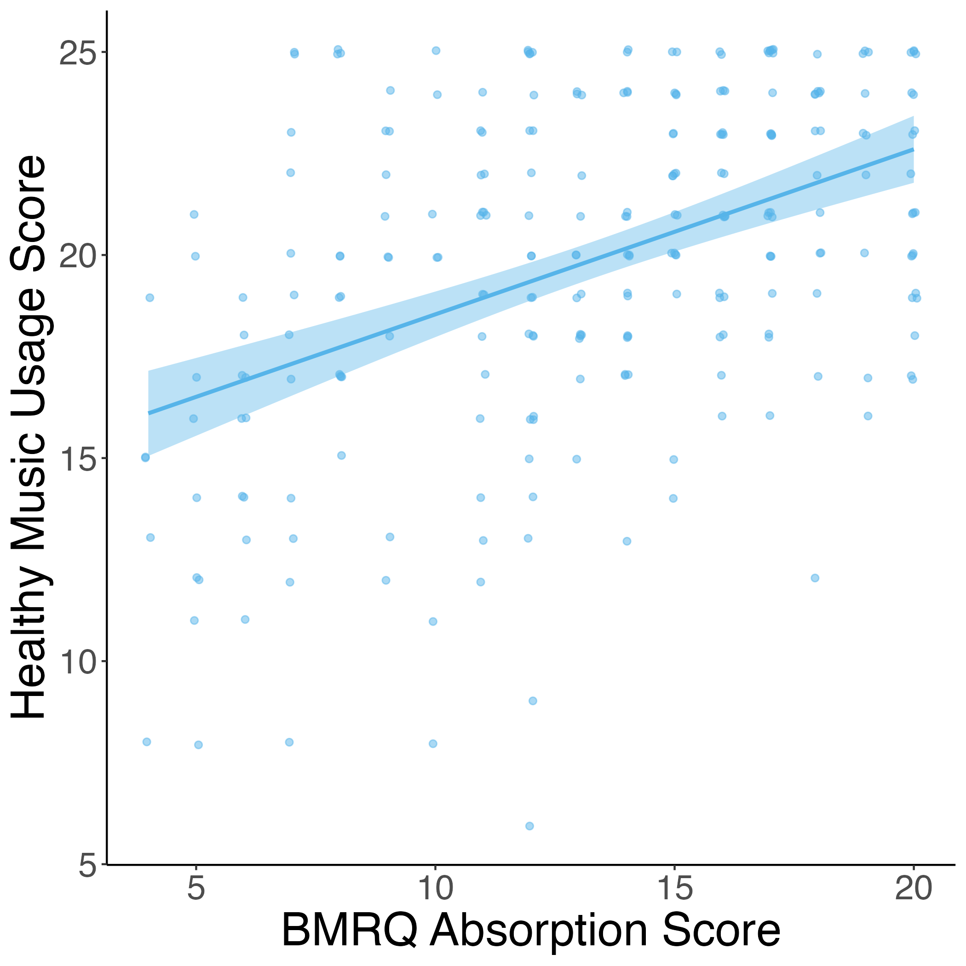
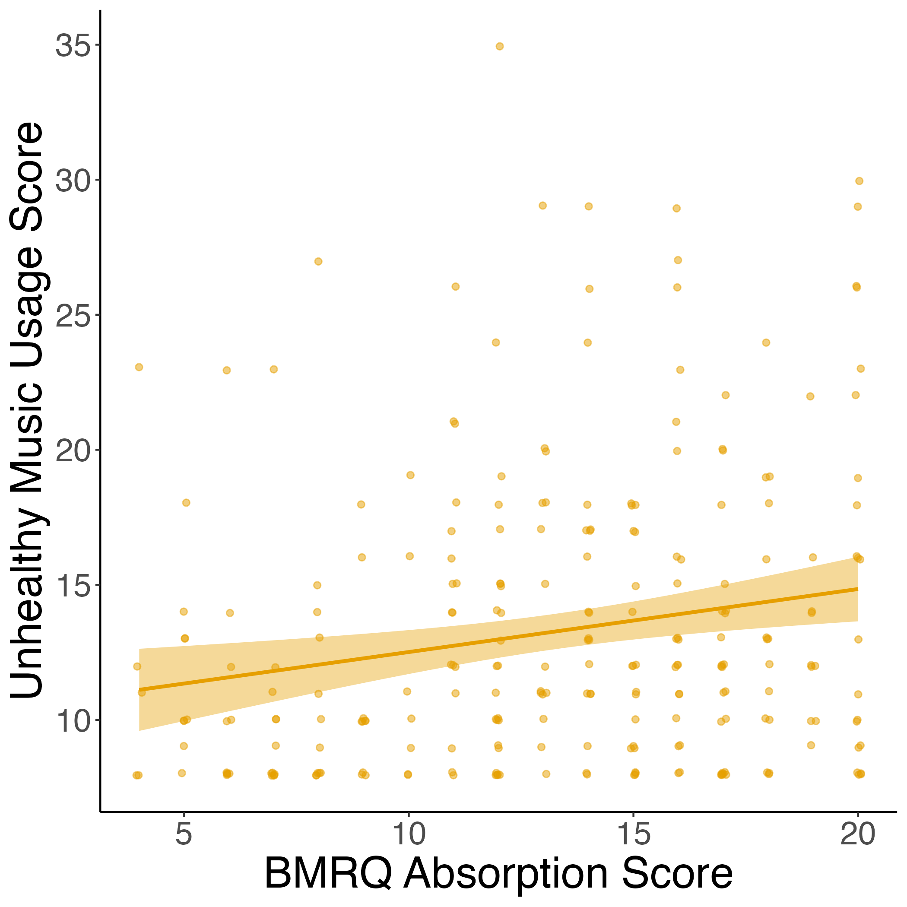
ABSORPTION INTO MUSIC POSITIVELY RELATED TO BOTH HEALTHY & UNHEALTHY MUSIC USAGE....
Healthy Music Usage
"Music helps me to relax."
Unhealthy Music Usage
"When I listen to music I get stuck in bad memories."
r = 0.44, p < 0.001
r = 0.19, p = 0.002
11
Notes:
Before we take a deep dive into what absorption into music might mean in this context, we first wanted to see if it was also linked to adaptive music usage. To do so, we correlated absorption scores on the eBMRQ to scores on the Healthy-Unhealthy Music Scale. This scale asks participants to rate how much they agree with specific music usage statements, and results in two scores: a healthy music usage score, with questions such as … and an unhealthy music usage score with questions such as ..
We found that….
Not much insight ..

Slide 12
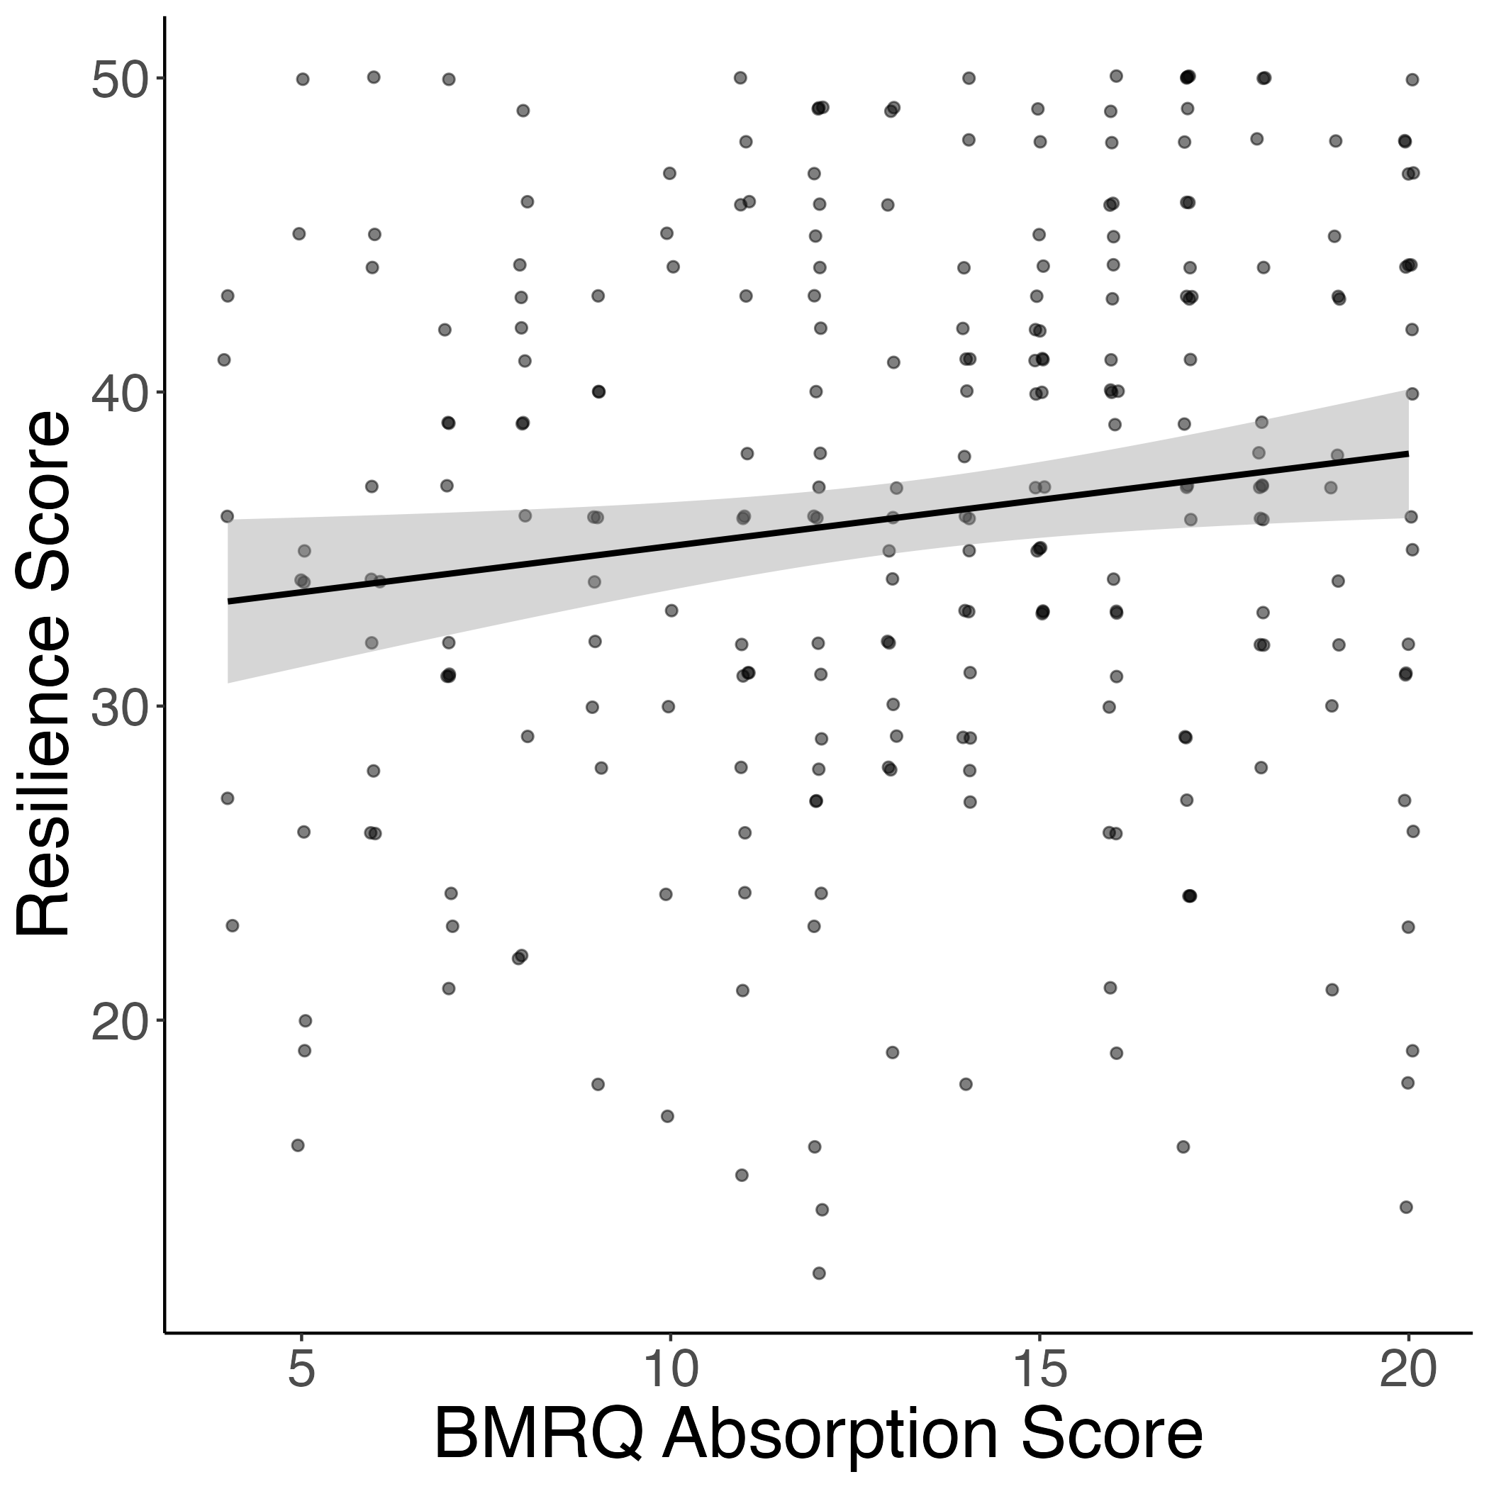
ABSORPTION ALSO POSITIVELY RELATED TO RESILIENCE
Resilience: “successfully adapting to difficult or challenging life experiences, through mental, emotional, and behavioral flexibility” (APA)
“I am able to handle unpleasant or painful feelings like sadness, fear, and anger.”
r = 0.14, p = 0.02
12
Notes:
As another test into whether absorption into music is adaptive, we correlated BMRQ absorption scores with a measure that is not related to music usage: resilience. This was measured using the conor-Davidson resilience scale, and revelaed that absorption was positively correlated with resilience, adding further evidence that absorption into music *is* in fact adaptive

Slide 13
WHY IS ABSORPTION ADAPTIVE? TAKING A CLOSER LOOK AT ITEMS ON THE HEALTHY-UNHEALTHY SCALE
I hide in my music because nobody understands me, and it blocks people out
When I listen to music I get stuck in bad memories
When I try to use music to feel better I actually end up feeling worse
I like to listen to songs over and over even though it makes me feel worse
Music makes me feel bad about who I am
Music gives me an excuse not to face up to the real world
It can be hard to stop listening to music that connects me to bad memories
Music leads me to do things I shouldn’t do
13
Notes:
If absorption into music is actually adaptive, then why was it significantly correlated with unhealthy music usage? To answer this question, we decided to take a closer look into the items of the unhealthy music usage scale

Slide 14
WHY IS ABSORPTION ADAPTIVE? TAKING A CLOSER LOOK AT ITEMS ON THE HEALTHY-UNHEALTHY SCALE
I hide in my music because nobody understands me, and it blocks people out
When I listen to music I get stuck in bad memories
When I try to use music to feel better I actually end up feeling worse
I like to listen to songs over and over even though it makes me feel worse
Music makes me feel bad about who I am
Music gives me an excuse not to face up to the real world
It can be hard to stop listening to music that connects me to bad memories
Music leads me to do things I shouldn’t do
“While listening to music, I may become so involved that I may forget about myself and my surroundings.”
14
Notes:
When we did this, two items stuck out quite clearly – these items seem to be indexing what we might call escapism, or using music to psychologically “leave” the context listeners are in. Now, this might be unhealthy in a context-independent way; however, when the context you’re in is adverse, then it might actually be adaptive to escape in this manner as a way to buffer the adversity around you.

Slide 15
IS ABSORPTION INTO MUSIC
ADAPTIVE IN ADVERSE CONTEXTS BECAUSE IT ALLOWS INDIVIDUALS TO 'ESCAPE' THESE CONTEXTS?
Trends
Ads
15
Notes:
This led us to our guiding question of our second study:

Slide 16
PARTICIPANTS
288 participants (141F; mean age = 38) recruited from a previous experiment
STUDY 2 METHODS
MEASURES
Same adversity measures as Study 1
BMRQ
Absorption in Music Scale (AIMS)
Escapism Scale
16
Sandstrom & Russo, 2011; Mas-Herrero et al., 2013; Stenseng et al., 2021
Notes:
To answer this question, we took a similar approach to study 1, with the exception that …

Slide 17
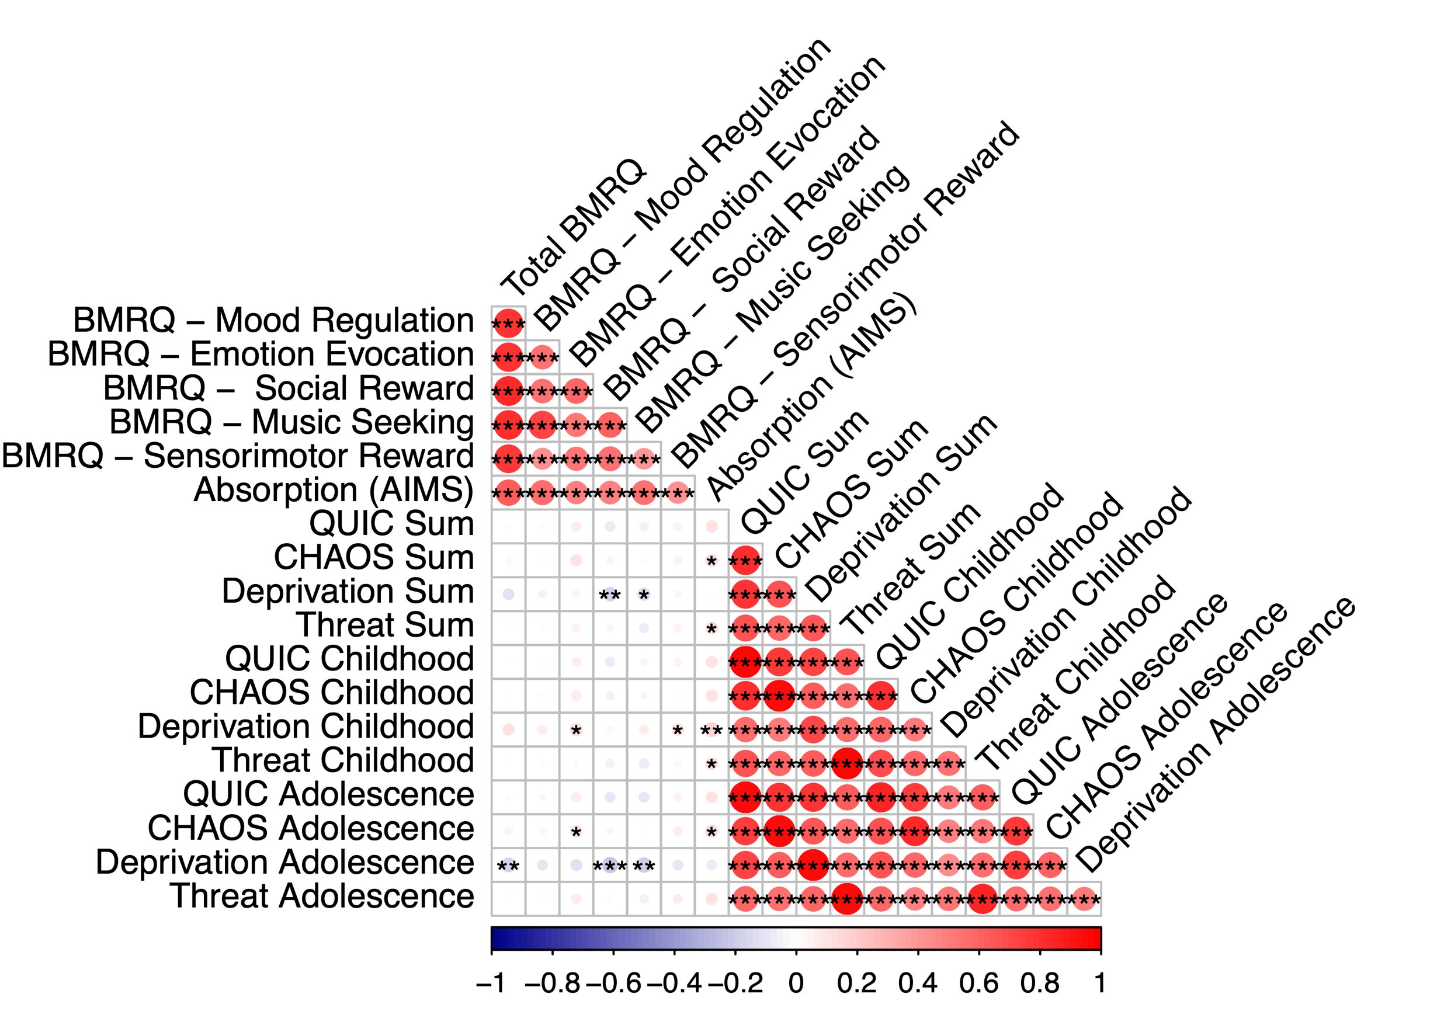
CONCEPTUAL REPLICATION OF CHAOS & THREAT ASSOCIATIONS WITH ABSORPTION (VIA AIMS)
17
Notes:
The first thing we did was replicate the results of study 1 using the AIMS, which revealed more dimensional specificity, with only threat and chaos sum scores being significantly correlated with AIMS in this sample

Slide 18
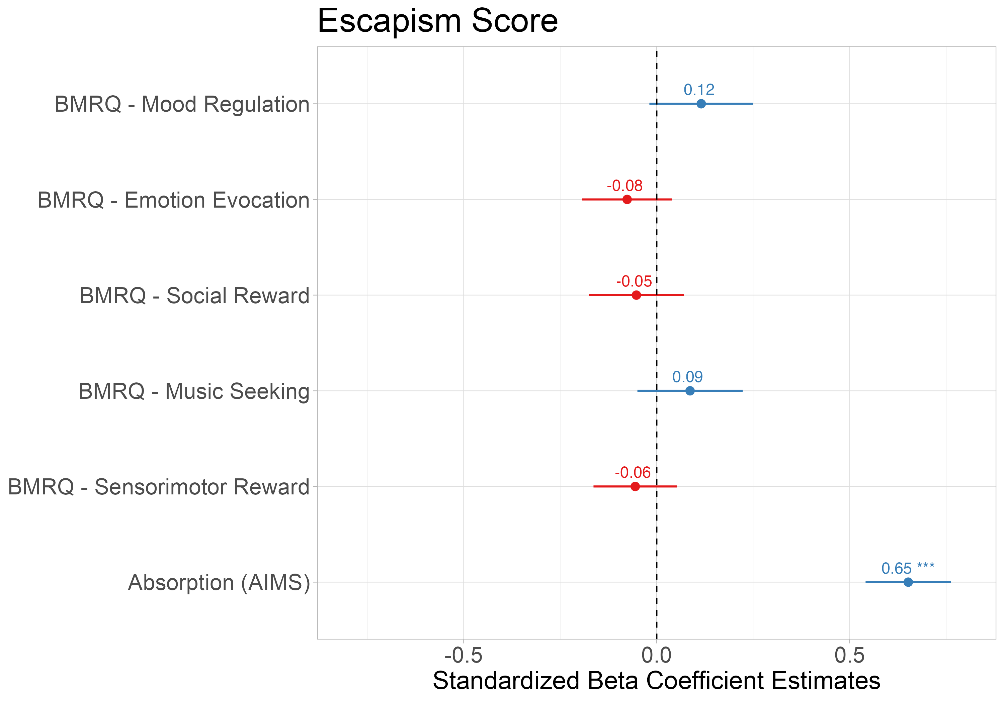
ABSORPTION INTO MUSIC ASSOCIATED WITH USING MUSIC FOR ESCAPISM
“When listening to music, I shut out the difficult things I don’t want to think about.”
Escapism ~ Absorption + Mood Regulation + Emotion Evocation + Social Reward + Music Seeking + Sensorimotor Reward
18
Notes:
The next thing we did with this sample was establish that absorption in music was related to reports of escapism in music. To do so, we modelled escapism scores on the escapism scale, which asks participants to rate agreement with specific statements such as .., as a function of AIMS scores while covarying for every subscale of the BMRQ. This revealed that AIMS was positively associated with escapism above and beyond the effects of other BMRQ subscale scores.

Slide 19
ABSORPTION MEDIATES THE RELATIONSHIP BETWEEN CHAOS AND RESILIENCE
AIMS scores did not mediate this relationship for childhood CHAOS scores (indirect effect: B = 0.02 [-0.001, 0.05]), but it did for adolescent CHAOS scores (indirect effect: B = 0.02 [0.001, 0.05]). The indirect effect for Threat (sum) scores was not significant (B = 0.05, [-0.04, 0.14]).
19
Notes:
Finally, we wanted to explore a model which included AIMS scores as a mediator between the relationship between the ELA measures significantly related to AIMS in our sample and resilience (here, CHAOS). The first thing we did was replicate the established relationship between ELA and resilience; higher CHAOS scores were related to lower resilience scores. Then, as we’ve seen in the previous slide, CHAOS was significantly related to AIMS. In this second sample we also replicated the positive relationship between AIMS and resilience from Study 1. Finally, with bootstrapped mediation, AIMS scores significantly mediated the relationship between CHAOS and resilience, which indicates that one way individuals with chaotic home environments develop resilience is through using music. When testing developmental timing of this relationship with CHAOS, only adolescent scores remained significant. Further, the relationship between threat and resilience was *not* significant, and I’ll get to why that might be in just a second.

Slide 20
DISCUSSION
Individuals who report experiencing early life adversity also report being highly absorbed by music
“Escaping” adverse contexts into music is one way individuals with ELA develop resilience
Likely not advantageous to psychologically escape threatening contexts
CHAOS – AIMS – Resilience mediation driven by adolescent CHAOS scores → increased agency in music listening during this time
20
Notes:
So, to conclude, we’ve shown twice that

Slide 21



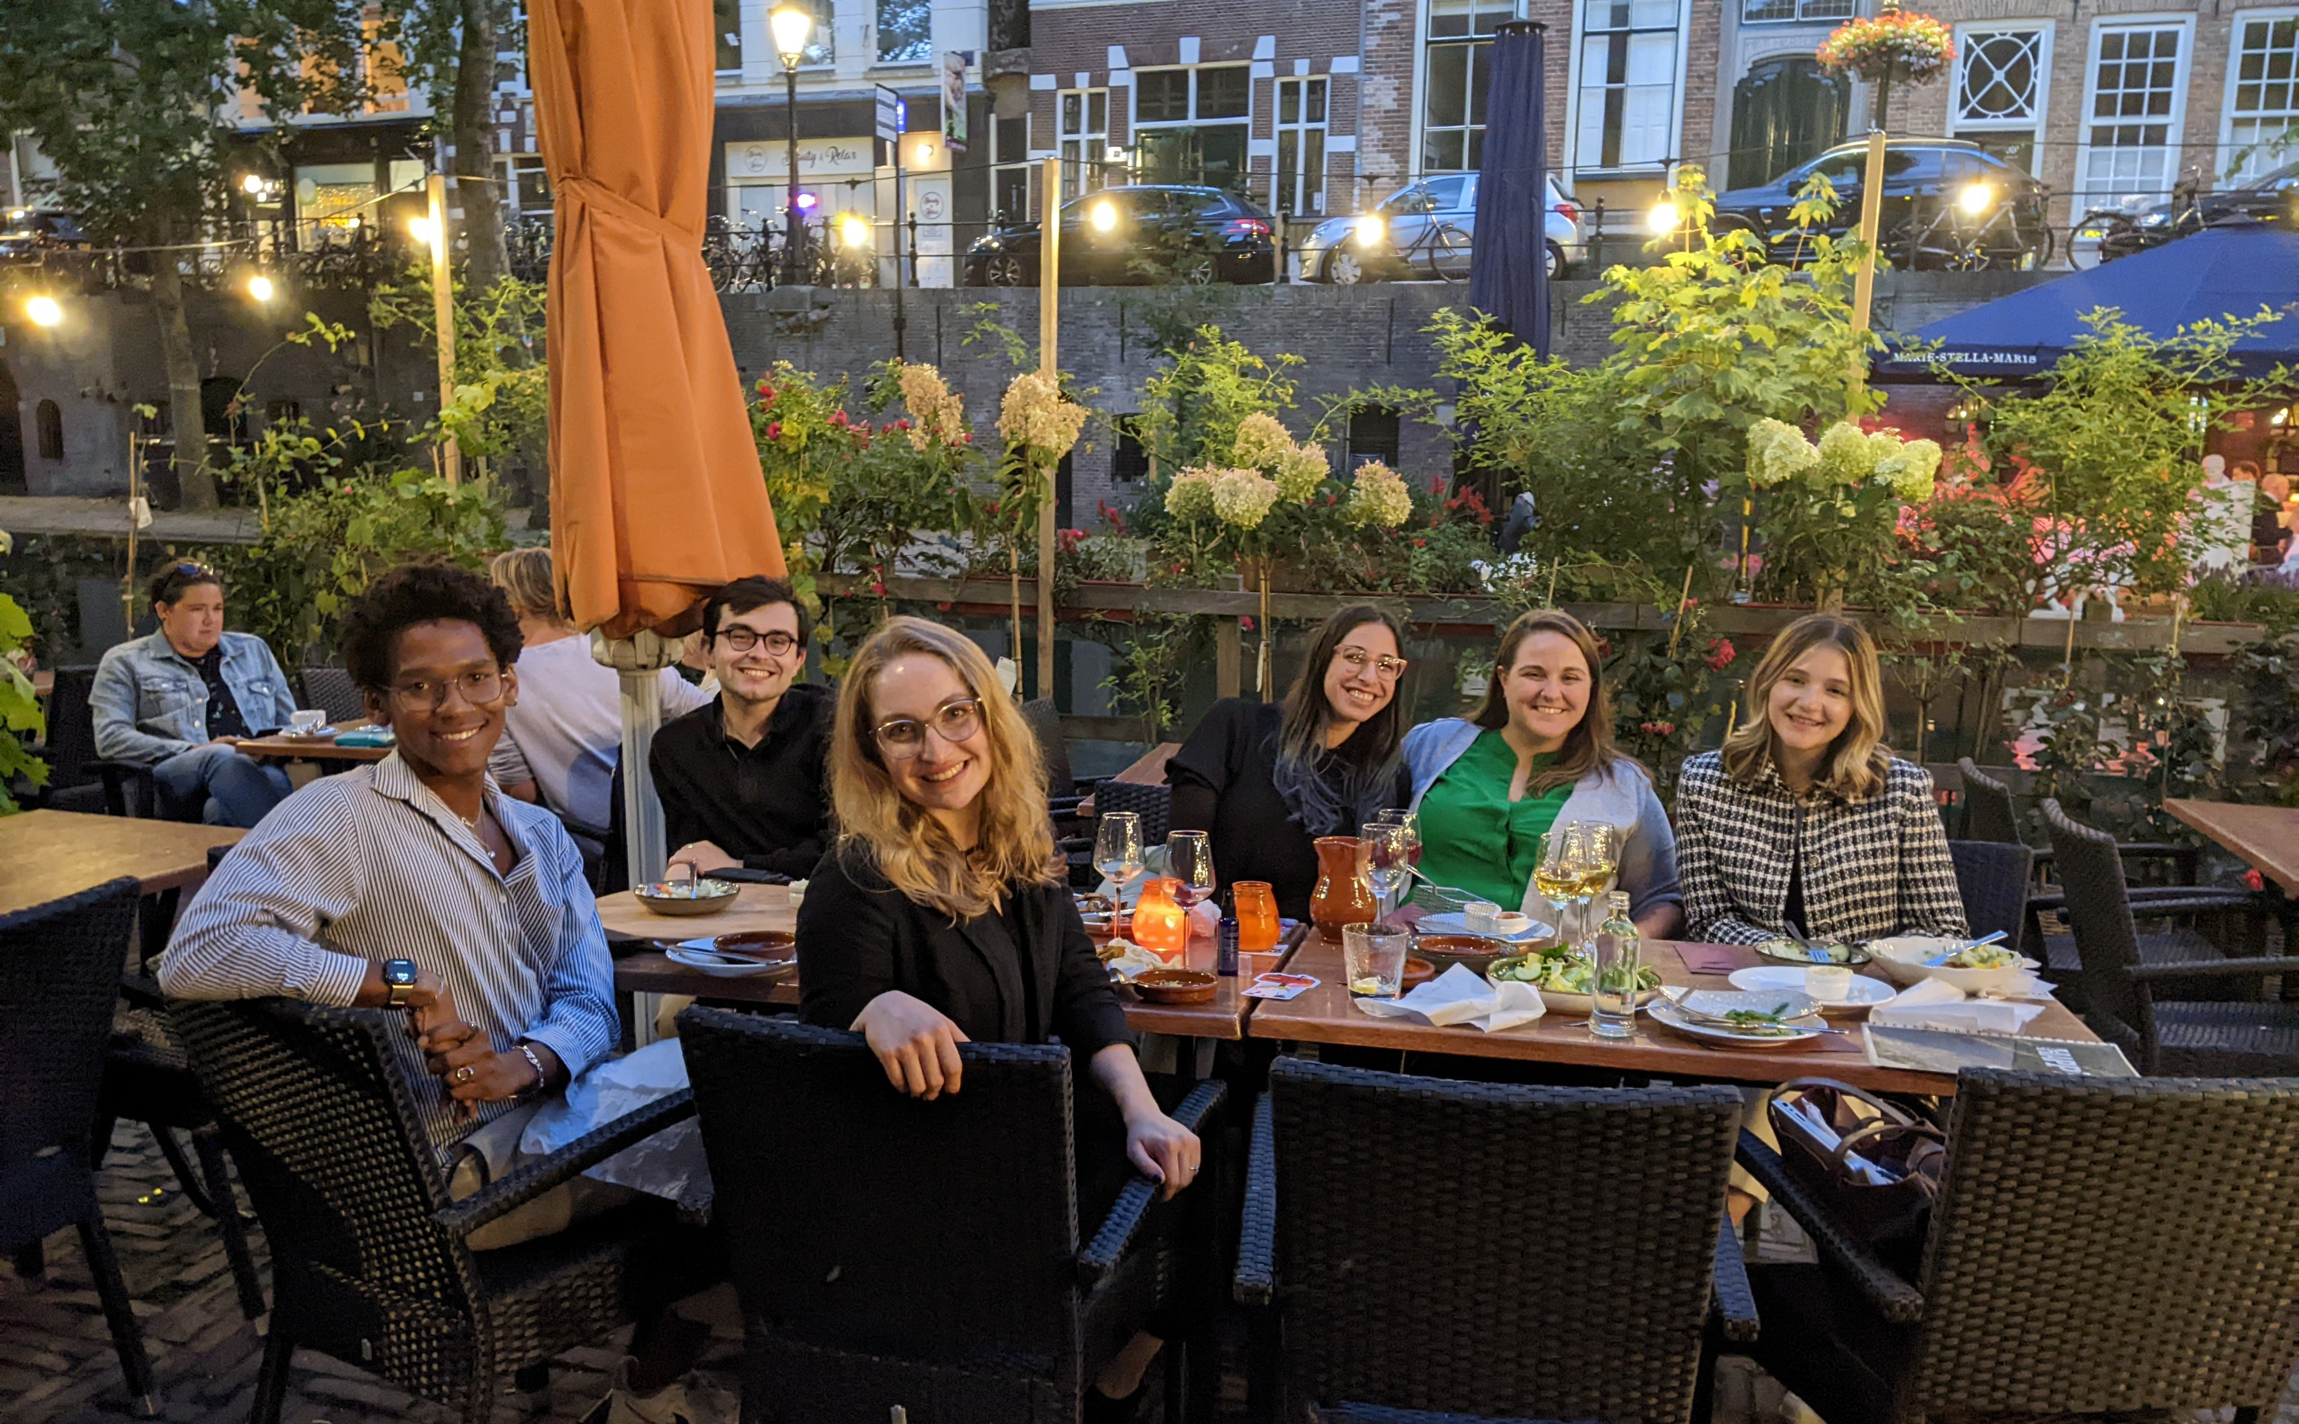


ACKNOWLEDGMENTS

Slide 22
QUESTIONS?

